Slide 1
LITERATURE REVIEW Design of Single Feed, Dual-Band Circularly Polarized Quad-Mode Slot Antenna Using Coupled Mode Theory
GROUP MEMBERS
CALVIN SEWORLUM MAWULORM
JESSICA ELIKPLIM TSITSIA
BERNARD KOBINA FORSON ESSEL
PROJECT SUPERVISOR: Dr. K. S. O. Kwakye

Slide 2
INTRODUCTION
Imagine a cell phone that could connect to your 4G network, your Wi-Fi, and even a super-fast 5G network, all at the same time.
That's the kind of versatility this research paper explores, but instead of a cell phone, it's about designing a single antenna that can do all that.
THE SLOT ANTENNA
SLOT ANTENNA: This antenna has a small opening, or "slot," in a metal plate of the ground. This slot is where the radio waves interact.
DUAL BAND: : It can work on two different frequency bands, like 2.5GHz and 5.0GHz (3G-5G)
CIRCULAR POLARIZATION: It can send and receive waves that spin in a circle, making it more reliable in certain situations
QUAD MODE: : It can operate in four different ways, allowing for even more flexibility.

Slide 3
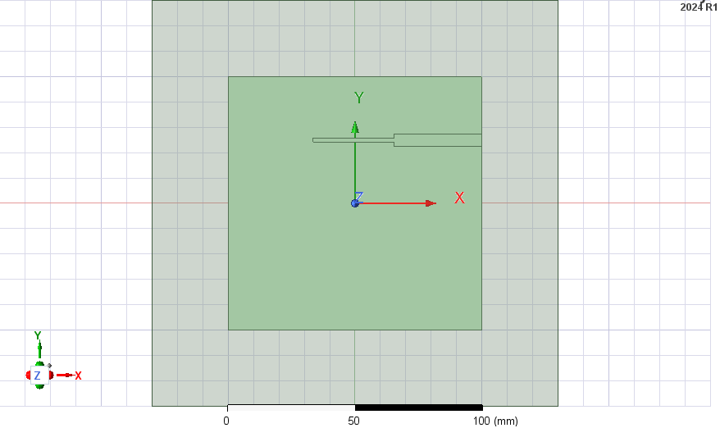
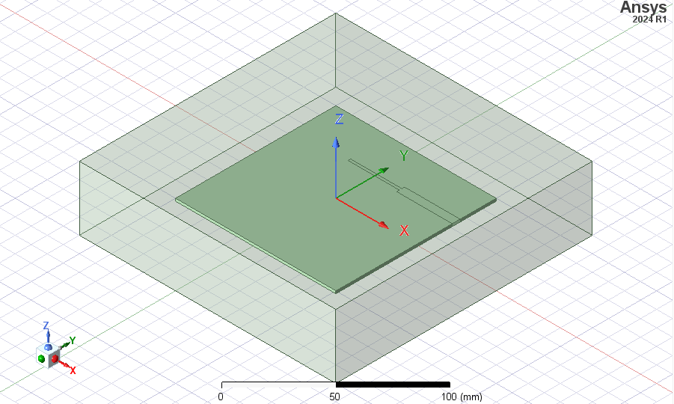
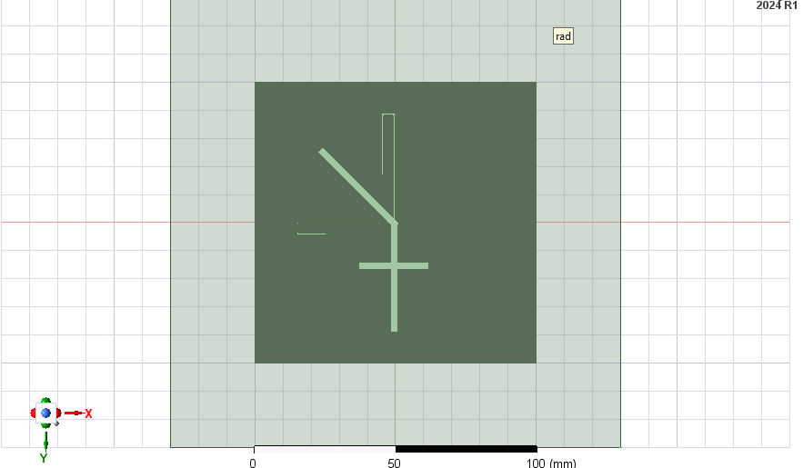
ANTENNA DESIGN

Slide 4
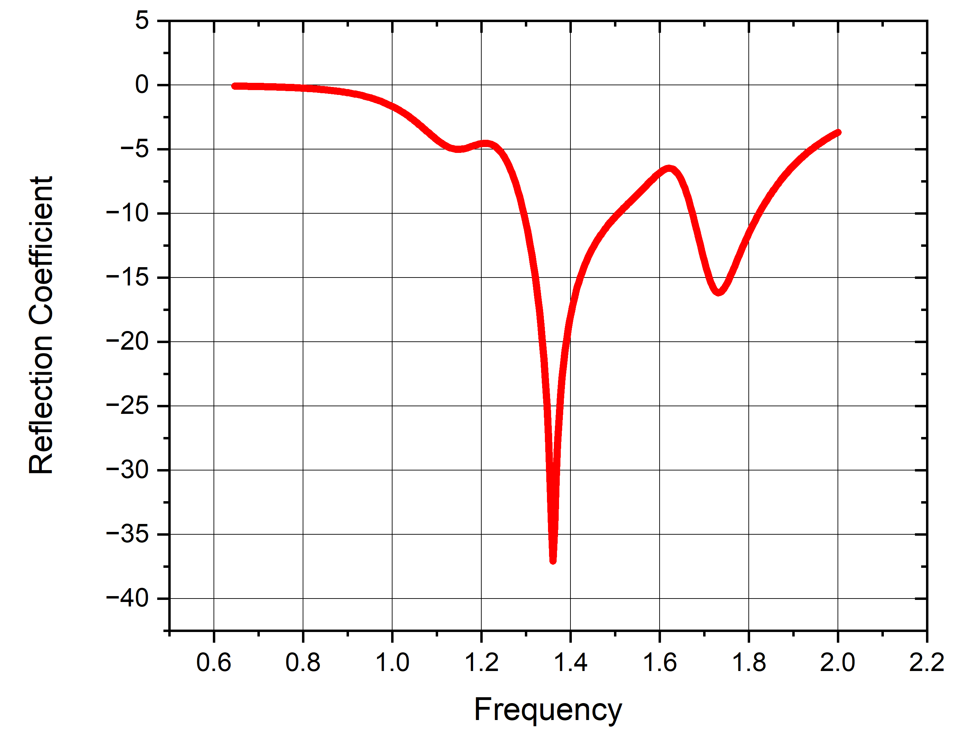
SIMULATION RESULTS

Slide 5

SIMULATION RESULTS

Slide 6
THANK YOU

